Slide 1
Game Bot: Final Year Project
Presenter:
Amit Saroj
MRT12UGBCS036
Shobhit University, Meerut
Mentor:
Prof.Jyoti Sharma
Shobhit University, Meerut

Slide 2
Contents
Project proposal
Project implementation
Report writing
Presentation/Viva

Slide 3
Writing the proposal
Introduction
Objective of your project
Methodology
Implementation
Resources required
Project Demo

Slide 4
Introduction
A "software robot" or software agent.
Especially an intelligent agent
There are various kinds of bots such as Web crawler, Internet bot, Chatterbot, Video game bot, Twitterbot.
Game Bot is automated expert agent software programmed in Python language.

Slide 5
Objective
To check the feasibility of the game name Flitz – colour
What is Flitz – Colour Game ?
This game test the reflex action of brain of persons in which,
User has to click on the specified colour in title box, to match the actual present three colour palette.
Game Bot checks the accuracy and bug in the programming of the game through automating the score and to check whether the sever load.

Slide 6
Resources required
The Game is made using Python 3 language.
Dependencies used are:
Pillow (Python Image Library).
Pywin32 (Python Windows Extension).
Numpy (Python numerical library).

Slide 7
Implementation
The main base on which this bot works is Image Processing.
The Bot recognize various mentioned pattern and by calculating it automatically clicks on the right coloured palette.
The calculation is done by collecting the required pattern image and convert it into numbers.
Process Flow Diagram :
Collect Pattern
Convert in numbers
Validate the numbers
Data Map with palette
Click on required palette
Repeat

Slide 8






Image to Numeric Conversion:
35498
34400
33211
32215
30465
32415
For Orange
For Green
For Gray
For Blue
For Red
For Purple

Slide 9
How Image Processing works?
Image is extracted.
Each Pixel of the Image is converted into Grayscale to reduce load on calculation.
Each Pixel is converted of image is then calculated into numeric form by Pil.getColor() in an array.
The calculated array is summed to get the unique colour ID.
That colour ID is matched with the Text ID of Image.
8572
(Unique ID)
Extracted Image
Converted to Grayscale
Each Pixel is summed using array

Slide 10
Pattern Recognition
The Pixel is converted into number using RGBA colour Scheme.
RGBA Stands for (Red Green Blue Alpha).

Slide 11
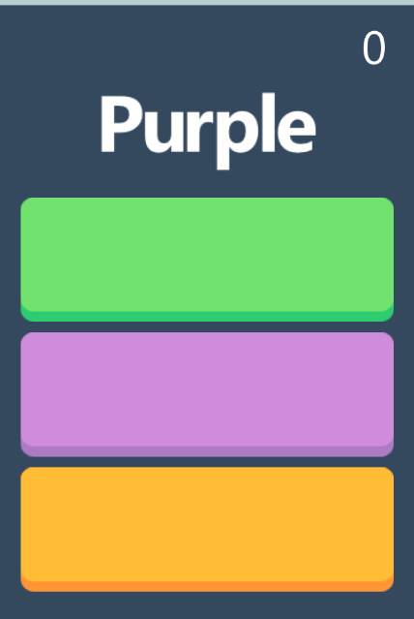
Process working
Pattern recognition and pattern mapping is all done in within 60 mini-second.

Slide 12
Data Mapping
Data mapping is done using PYWIN32 libraries.
Various click target is already selected and saved.
From selected target is the appropriate target is check and the mousePos() Method will find the Position mention and return Click() method.

Slide 13
Bot Body
Layout of the bot is made using tkinter module in Python.
In tkinter all the instances are precalled in loop till all the process is completed.
So the it will visible to user.

Slide 14
Conclusion:
By combining the power of Python, Pillow, pywin32 this bot is made.
It will run on Flitz-color of web game.
It will automated the scoring of the game.
To check the feasibility.

Slide 15
Project Demo
https://github.com/amitsaroj001/GameBot_Fitz-Color/blob/master/fitz.py

Slide 16
THANK YOU

